Slide 1
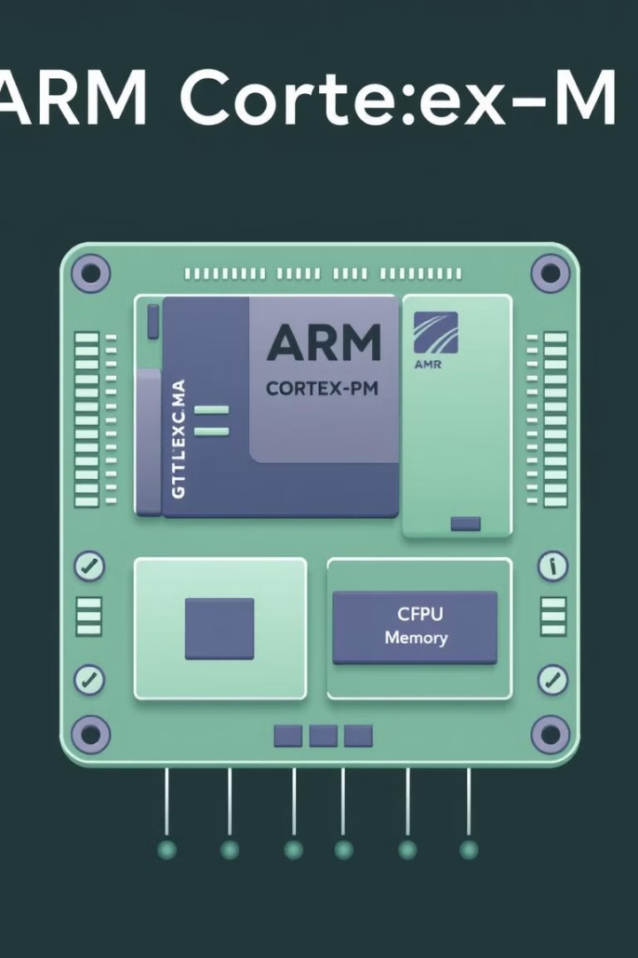
Understanding the ARM Cortex-M Series: A Deep Dive
The ARM Cortex-M Series is a powerful and versatile family of processor cores designed for embedded systems and microcontrollers. This deep dive will explore the architecture, features, and real-world applications of these industry-leading processors.

Slide 2
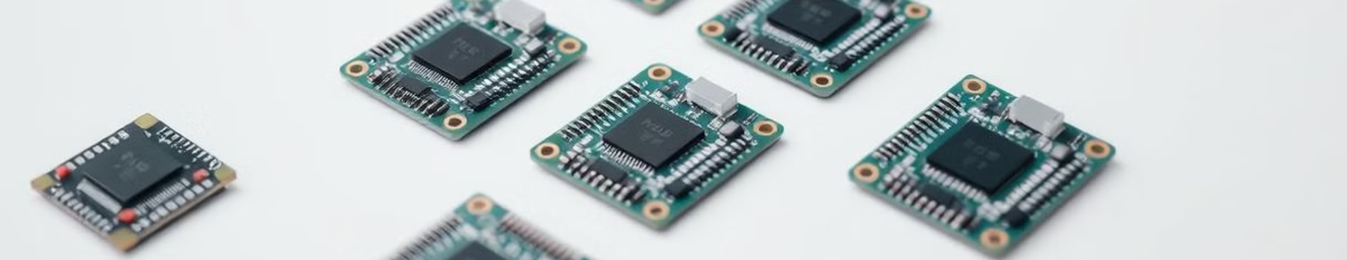


Introduction to the ARM Cortex-M Processor Family
1
Driving Embedded Innovation
2
Scalable Performance
3
Robust Ecosystem
The Cortex-M series enables a new generation of smart, connected devices across industries from IoT to automotive.
With variants ranging from ultra-low power to high-performance, there's a Cortex-M processor to fit any embedded application.
A thriving community of partners and developers ensures a wealth of tools, software, and support for Cortex-M-based designs.

Slide 3
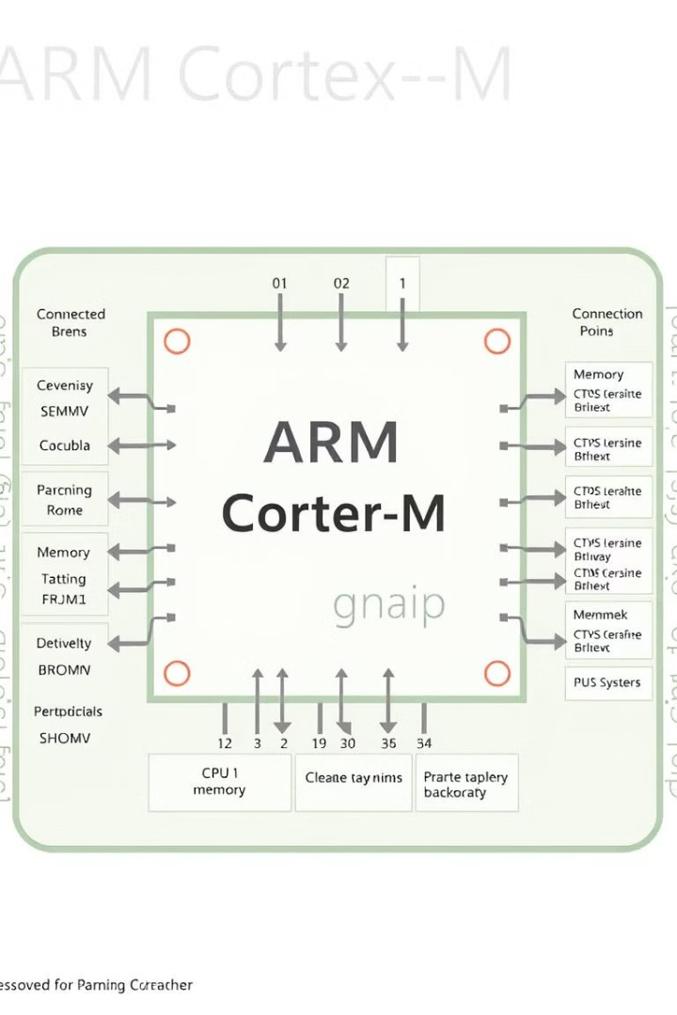
Architectural Overview of the Cortex-M Series
1
Reduced Instruction Set
Cortex-M processors utilize a compact 16-bit instruction set for efficient code execution and low memory footprint.
2
Harvard Architecture
Separate instruction and data memories enable parallel access for improved performance and reduced power consumption.
3
Optimized Peripherals
Integrated peripherals like timers, ADCs, and communication interfaces simplify system design and reduce component count.

Slide 4


Key Features and Capabilities of the Cortex-M Series
Low Power
Real-Time Performance
Robust Security
Low Power
Cortex-M processors are designed for energy-efficient operation, with advanced power management features and sleep modes.
Deterministic behavior, fast interrupt handling, and low latency make Cortex-M cores ideal for real-time applications.
Built-in security features like memory protection and cryptographic accelerators help safeguard embedded systems.
Cortex-M processors are designed for energy-efficient operation, with advanced power management features and sleep modes.

Slide 5
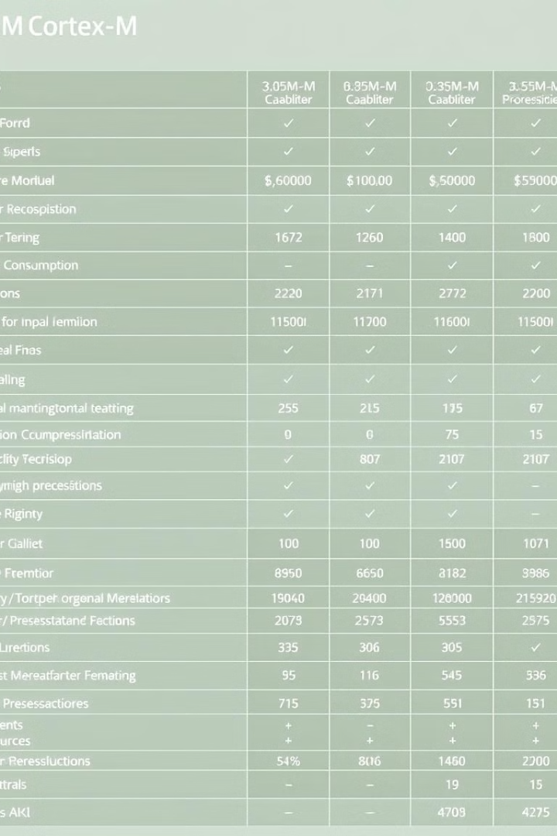


Comparing the Cortex-M Processor Variants
Processor
Performance
Power
Peripherals
Cortex-M0
32 MHz
Ultra-low
Basic
Cortex-M4
120 MHz
Low
Advanced
Cortex-M7
300 MHz
Moderate
Extensive

Slide 6
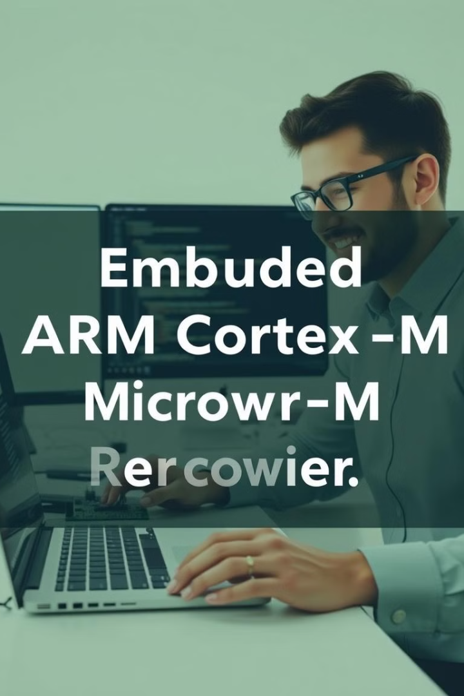



Software Development for Cortex-M Processors
Toolchains
Comprehensive development tools like ARM Keil and IAR Embedded Workbench simplify programming and debugging.
Programming Languages
Cortex-M processors support a variety of languages, including C, C++, and assembly, for maximum flexibility.
Real-Time OS
Popular RTOS options like FreeRTOS and Mbed OS provide pre-built functionality for Cortex-M-based designs.

Slide 7
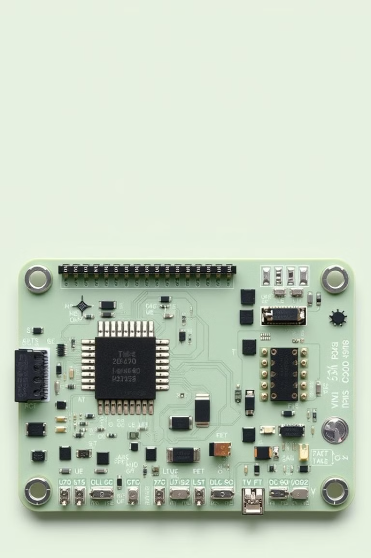



Optimizing Performance and Power Efficiency
Clock Gating
Selectively disabling unused clock domains reduces dynamic power consumption without impacting performance.
Memory Management
Careful allocation of code and data in memory can boost cache hit rates and improve execution speed.
Intelligent Peripherals
Cortex-M processors feature smart peripherals that can operate independently, reducing the load on the CPU.

Slide 8
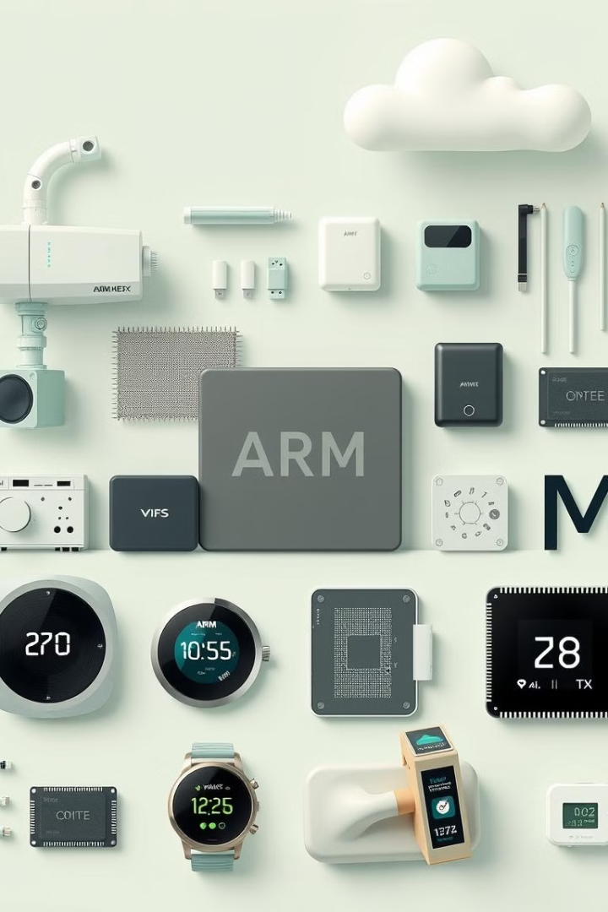
Real-World Applications of Cortex-M Processors
Industrial Automation
Consumer Electronics
Cortex-M cores power a wide range of industrial controls, sensors, and programmable logic controllers.
Cortex-M processors are found in smart home devices, wearables, and other IoT products that require low power and high performance.
Automotive Systems
Cortex-M-based microcontrollers are essential for engine management, infotainment, and advanced driver assistance systems.

Slide 9
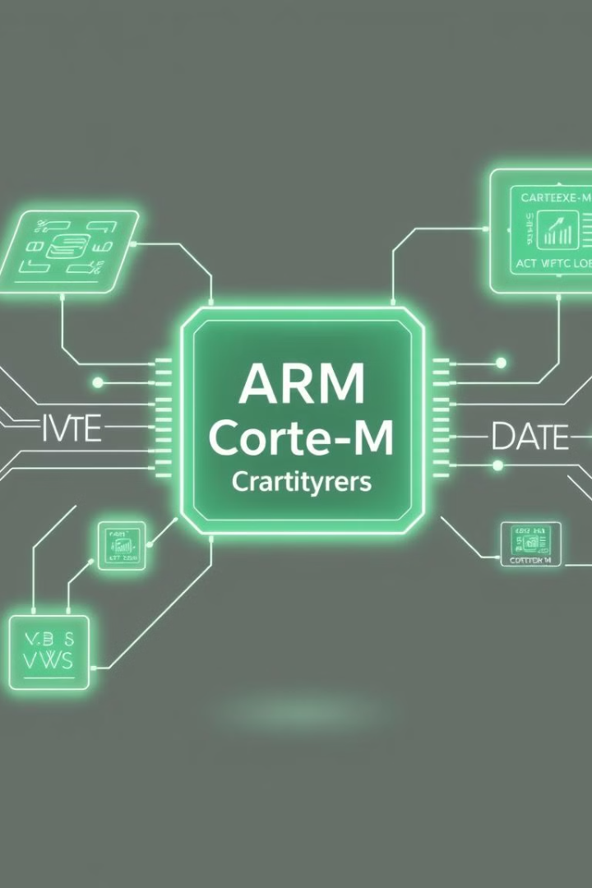

Conclusion and Future Outlook
As embedded systems continue to grow in complexity and importance, the ARM Cortex-M series will remain at the forefront of innovation, driving the next generation of smart, connected devices. With their unparalleled balance of performance, power efficiency, and security, Cortex-M processors are poised to play a pivotal role in shaping the future of the digital world.

